Slide 1
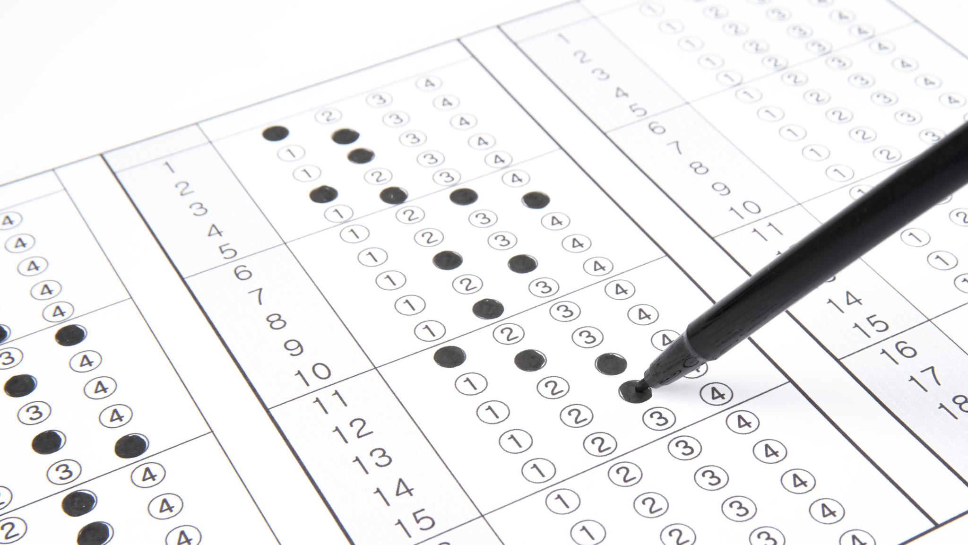
Test 1 STA100S
2022

Slide 2
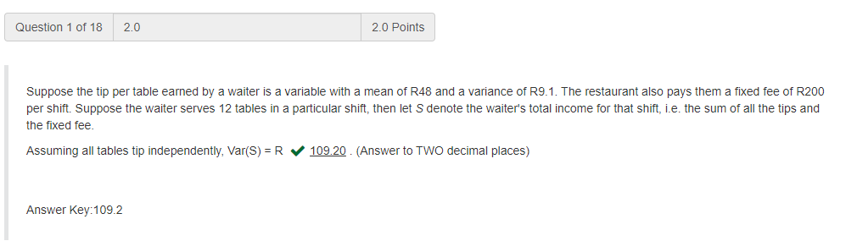
Question 1

Slide 3
Question 1

Slide 4
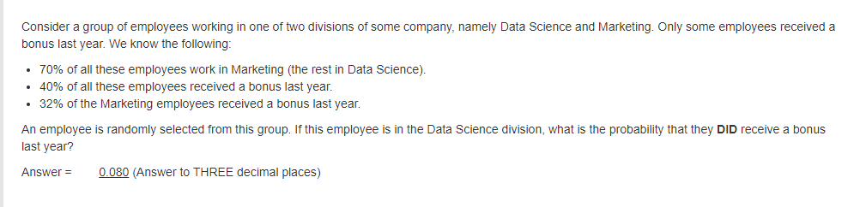
Question 2

Slide 5
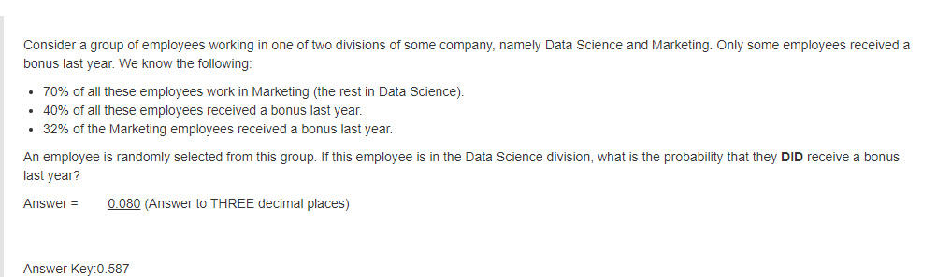
Question 2
0.543

Slide 6
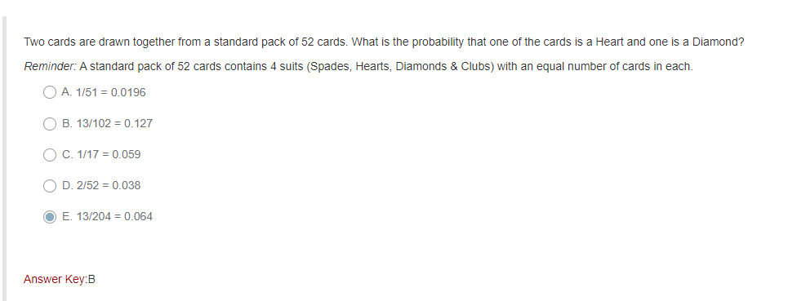
Question 3

Slide 7
Question 3

Slide 8
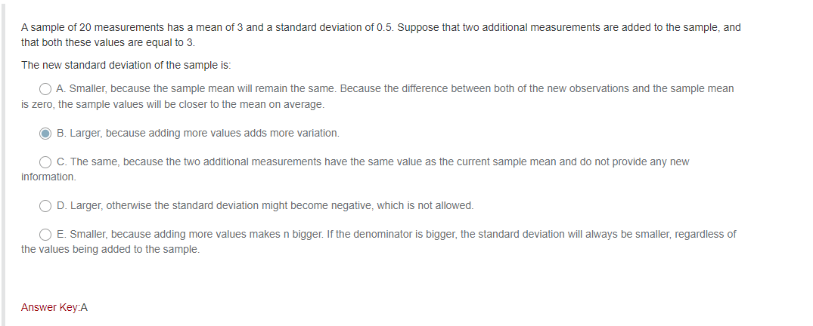
Question 4

Slide 9
Question 4

Slide 10
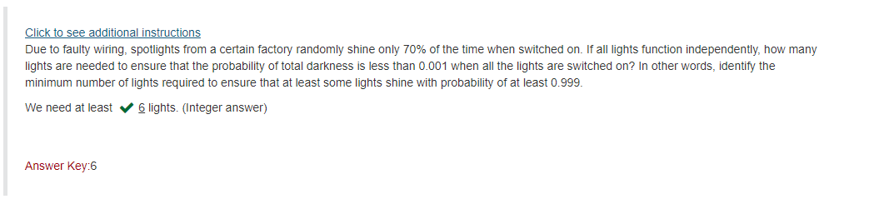
Question 5

Slide 11
Question 5

Slide 12
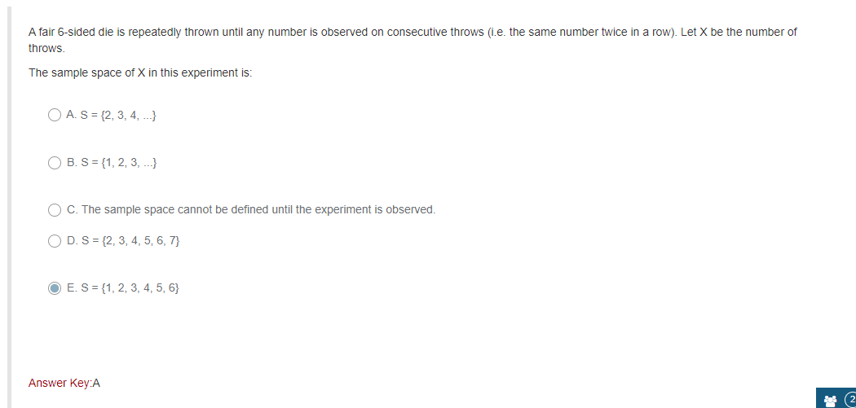
Question 6

Slide 13
Question 6

Slide 14
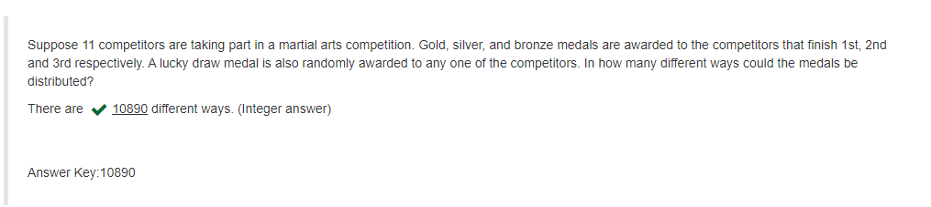
Question 7

Slide 15
Question 7

Slide 16
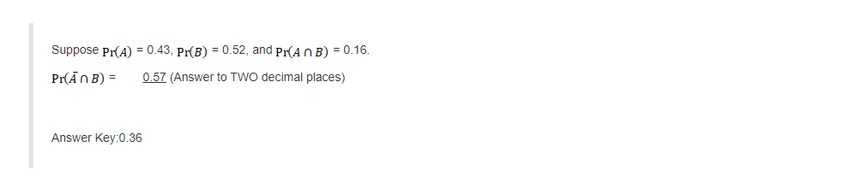
Question 8

Slide 17
Question 8

Slide 18
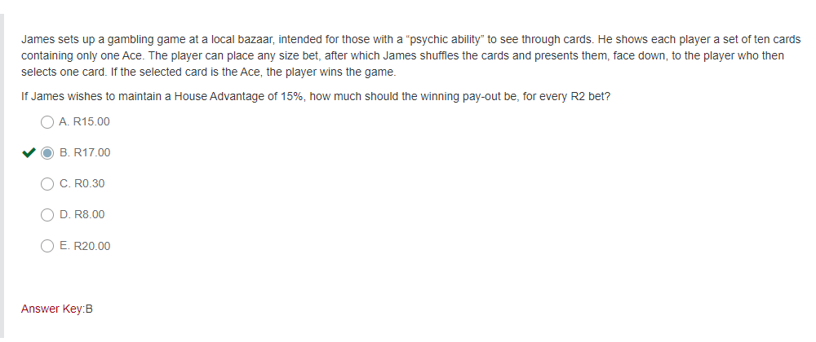
Question 9

Slide 19
Question 9

Slide 20
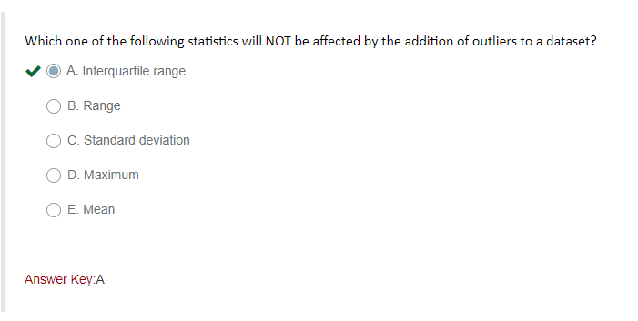
Question 10

Slide 21
Question 10

Slide 22
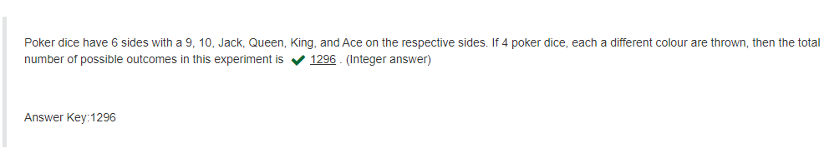
Question 11

Slide 23
Question 11

Slide 24
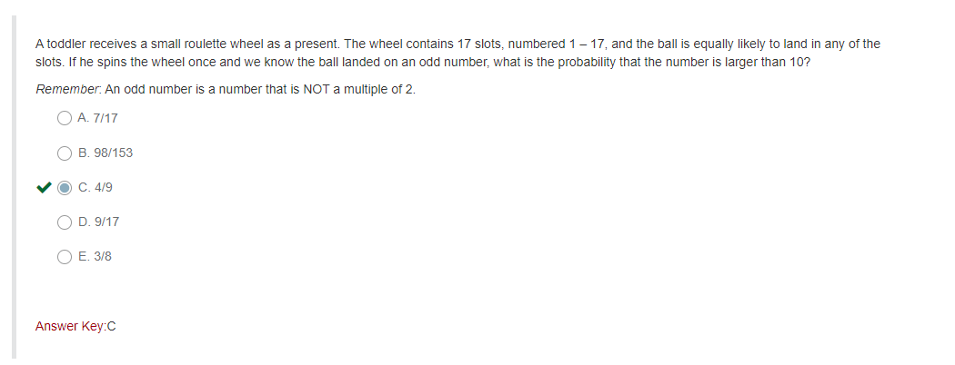
Question 12

Slide 25
Question 12

Slide 26
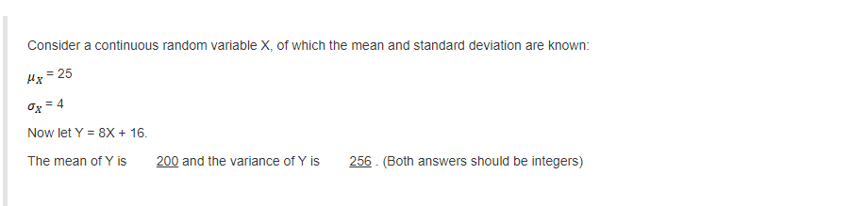
Question 13

Slide 27
Question 13

Slide 28
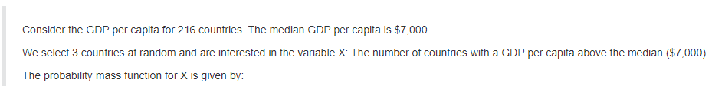
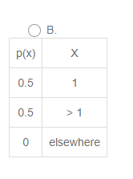
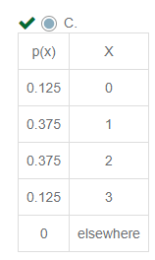
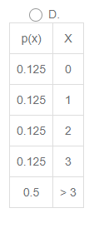
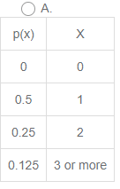
Question 14

Slide 29
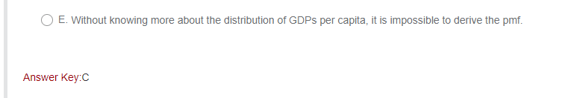
Question 14

Slide 30
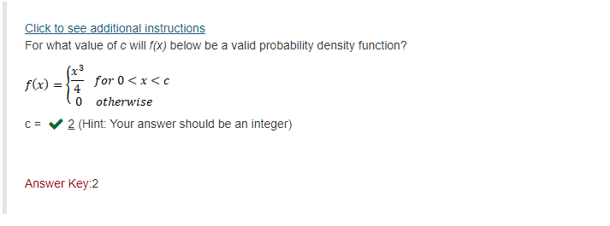
Question 15

Slide 31
Question 15

Slide 32
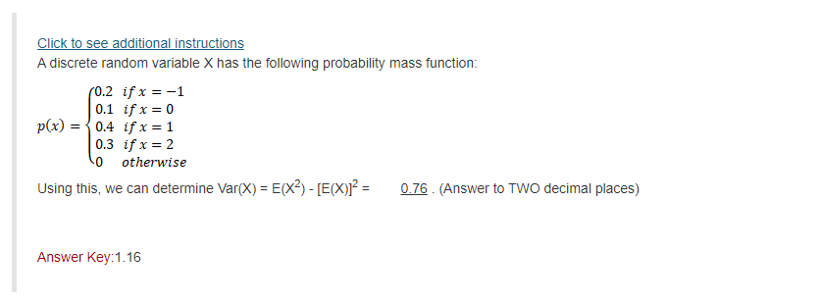
Question 16

Slide 33
Question 16

Slide 34
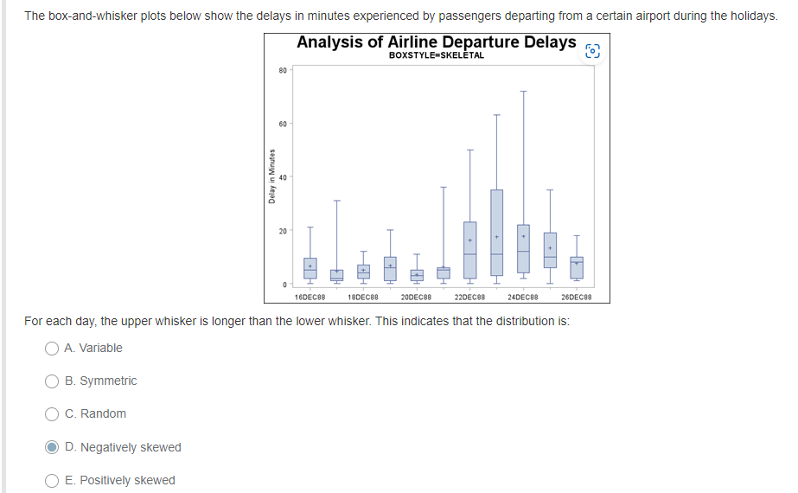
Question 17

Slide 35

Question 17

Slide 36
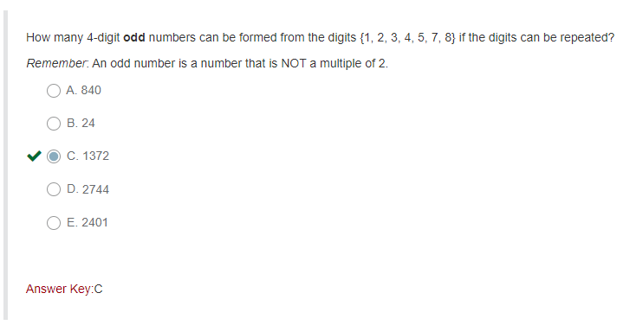
Question 18

Slide 37
Question 18

